Slide 1
Creating Views

Slide 2
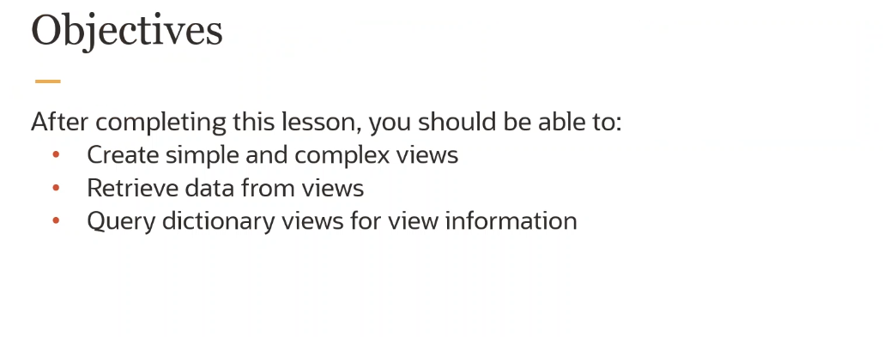

Slide 3
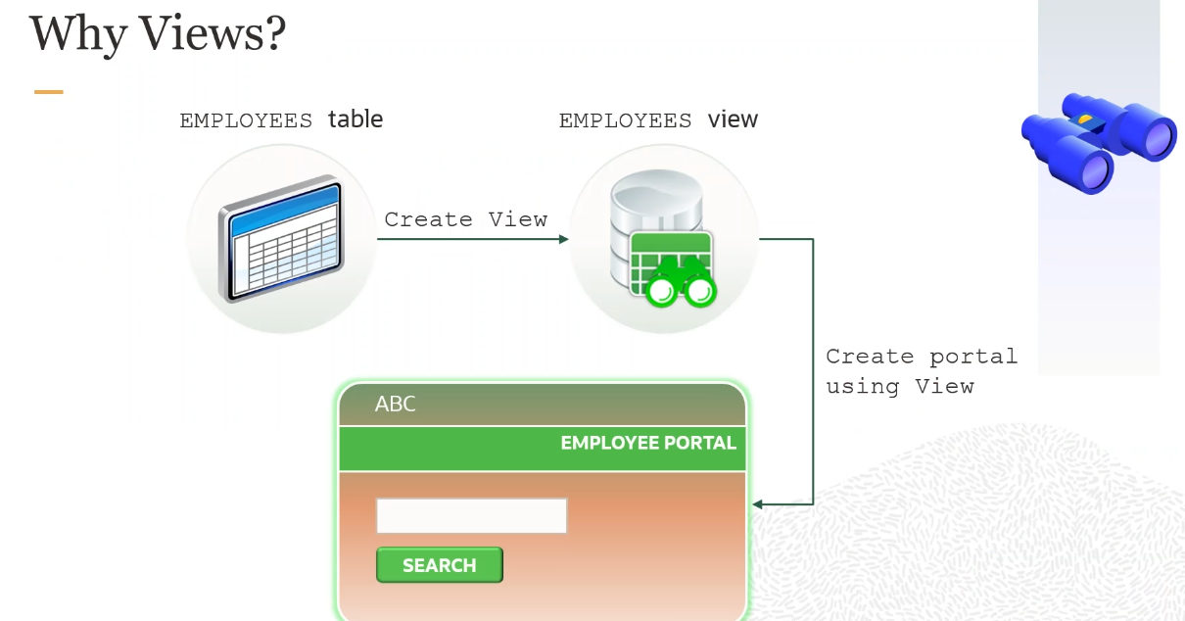

Slide 4
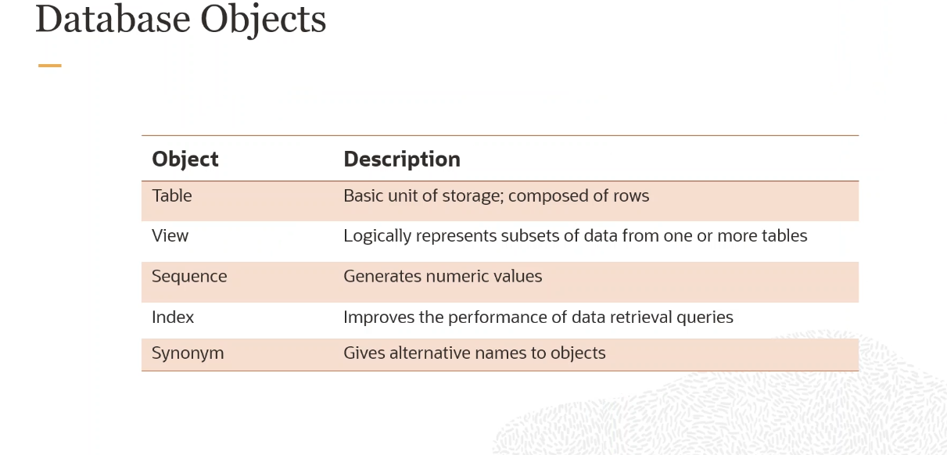

Slide 5
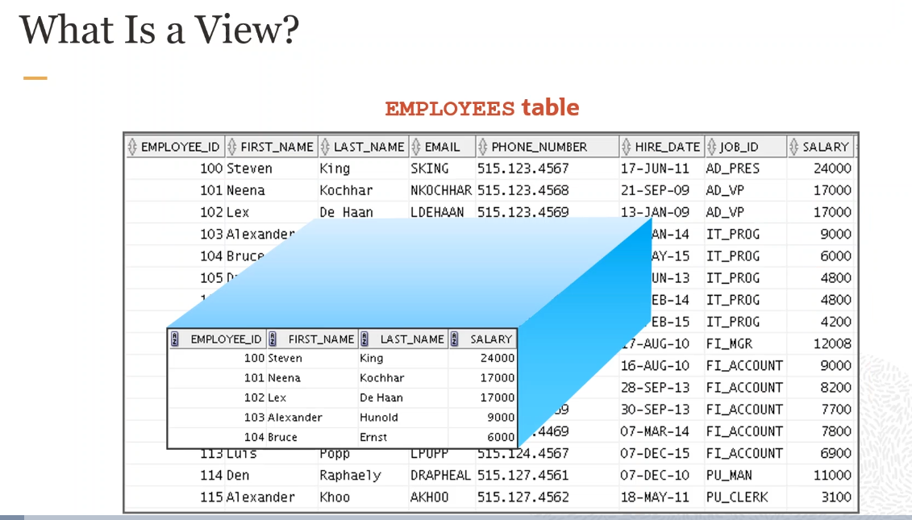

Slide 6
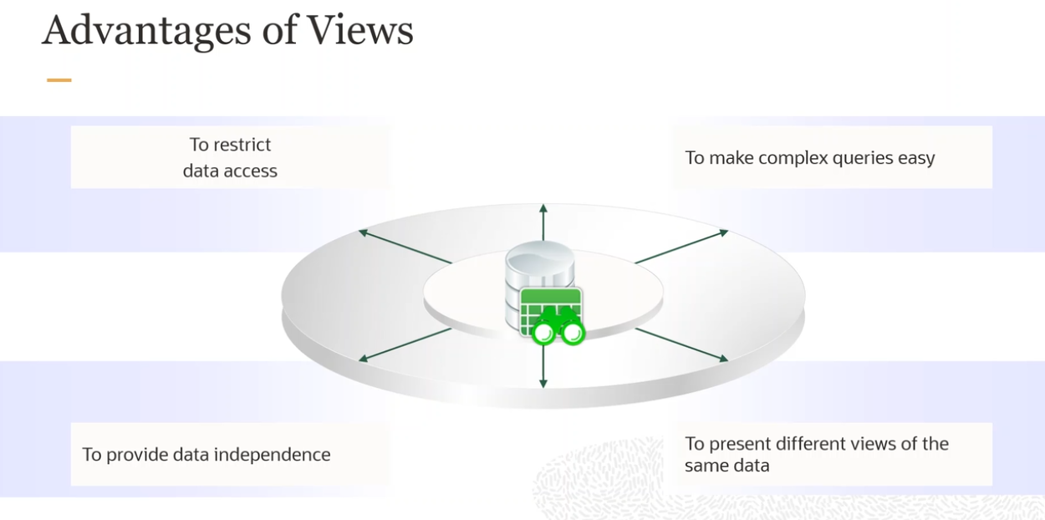

Slide 7
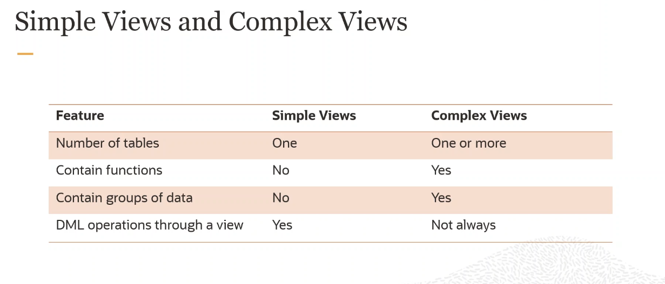

Slide 8
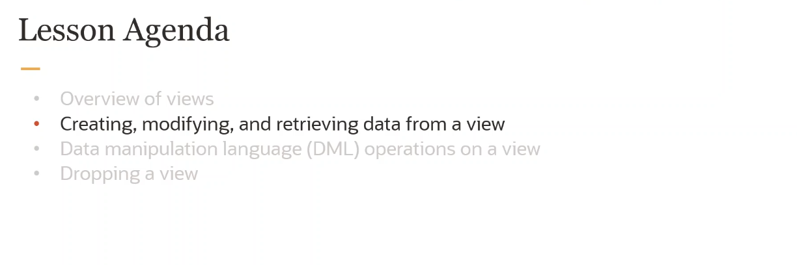

Slide 9
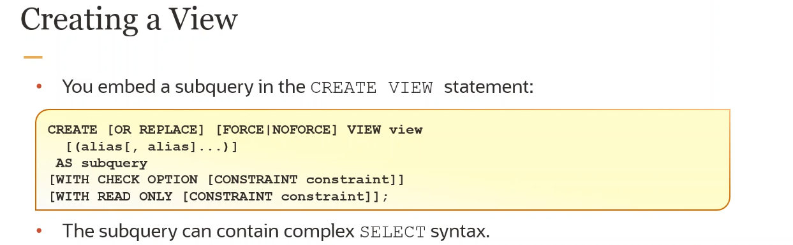

Slide 10
FORCE Specify FORCE if you want to create the view regardless of whether the base tables of the view or the referenced object types exist or the owner of the schema containing the view has privileges on them. These conditions must be true before any SELECT, INSERT, UPDATE, or DELETE statements can be issued against the view. If the view definition contains any constraints, CREATE VIEW ... FORCE will fail if the base table does not exist or the referenced object type does not exist. CREATE VIEW ... FORCE will also fail if the view definition names a constraint that does not exist.
NO FORCE Specify NOFORCE if you want to create the view only if the base tables exist and the owner of the schema containing the view has privileges on them. This is the default.

Slide 11
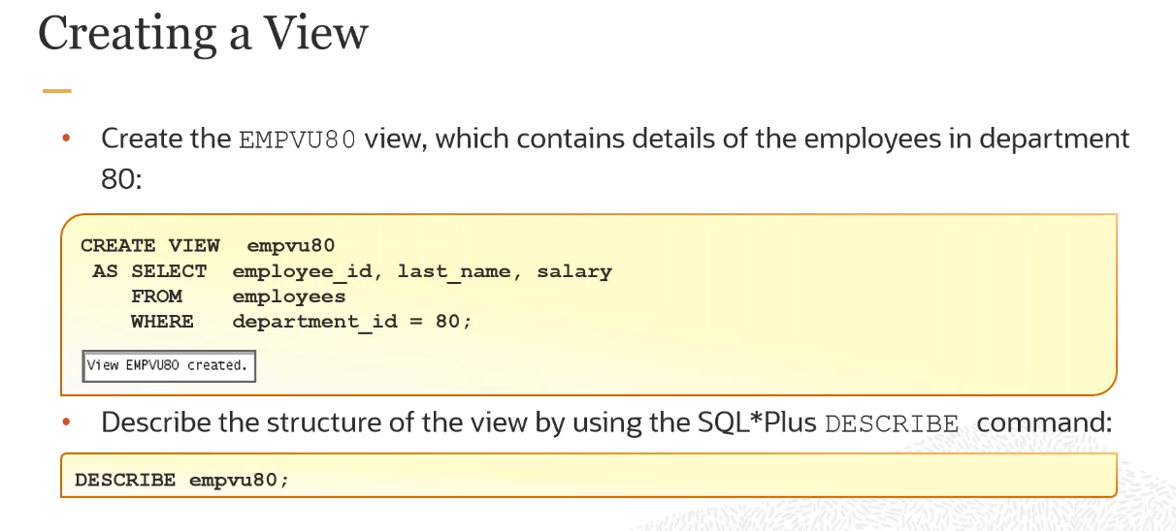

Slide 12
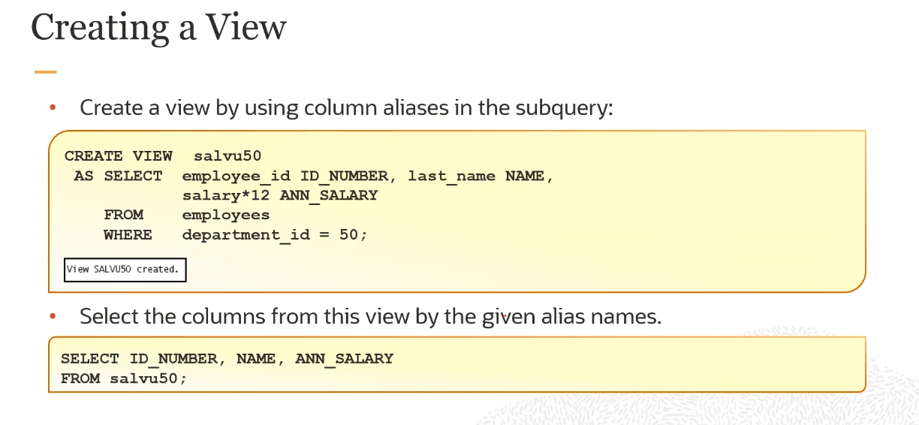

Slide 13
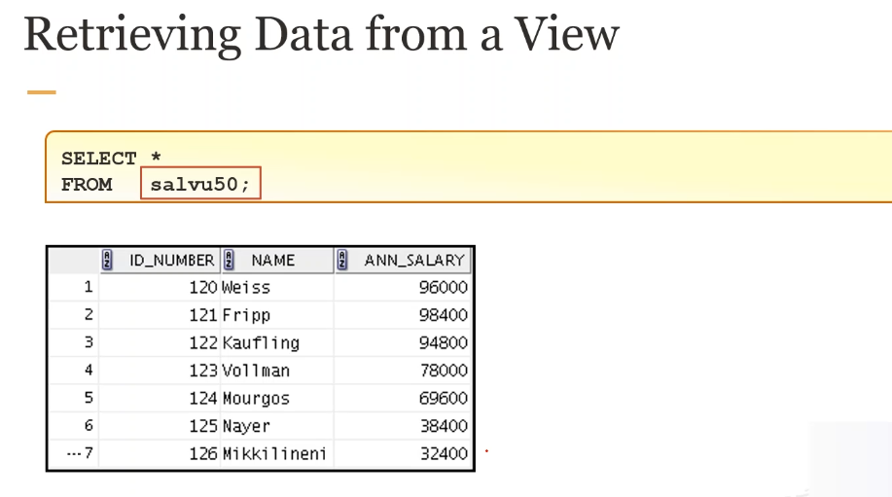

Slide 14
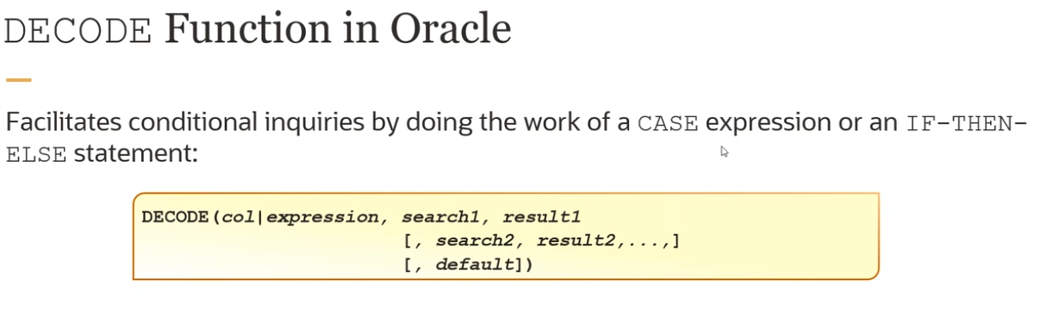

Slide 15
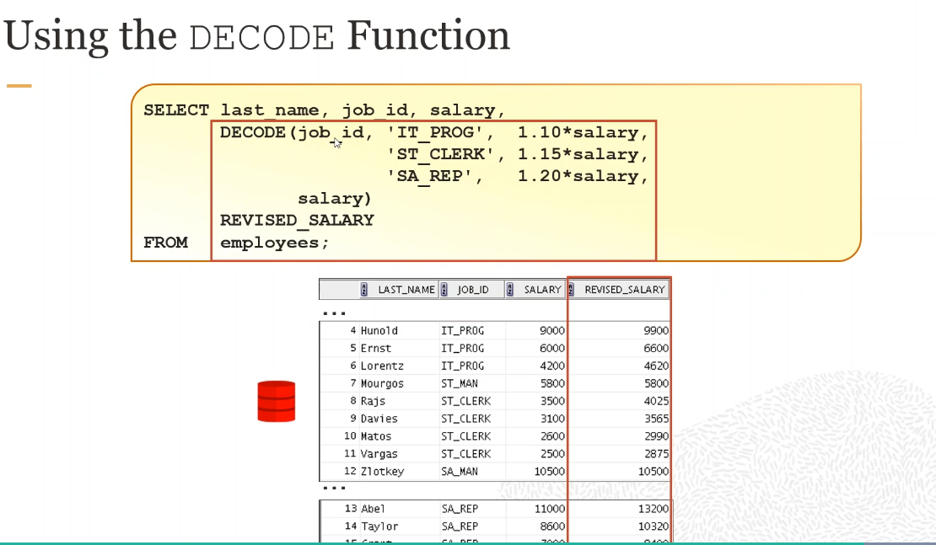

Slide 16
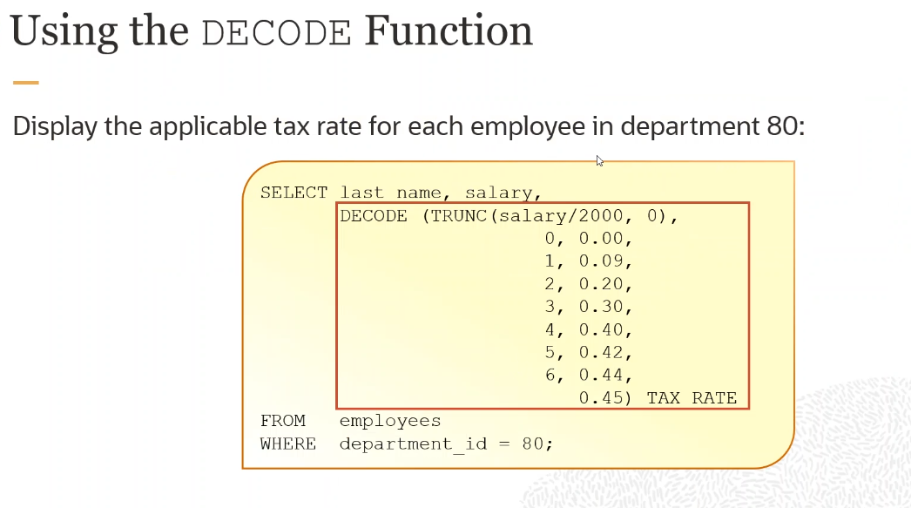

Slide 17
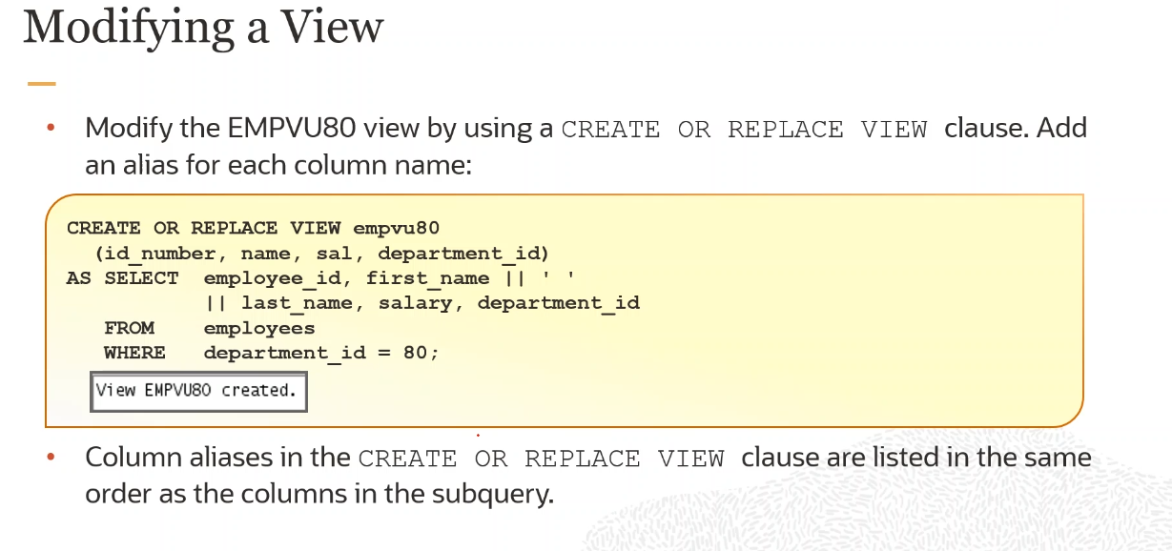

Slide 18
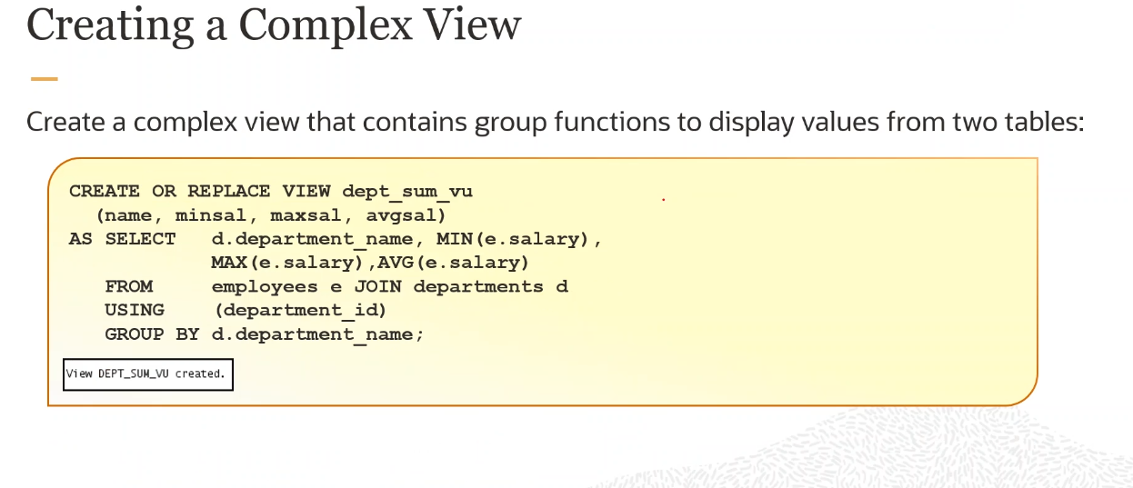

Slide 19
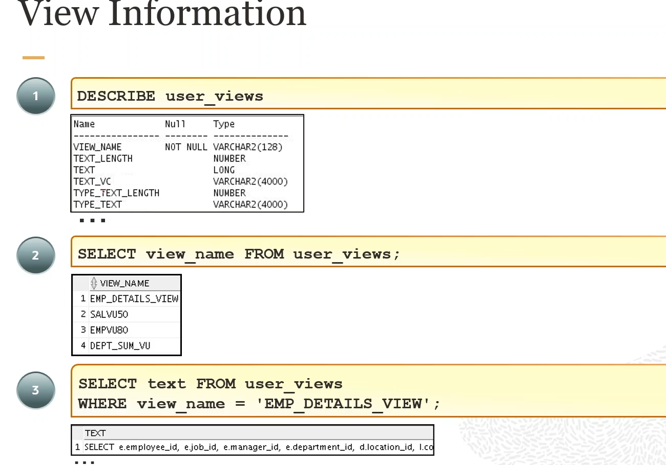

Slide 20
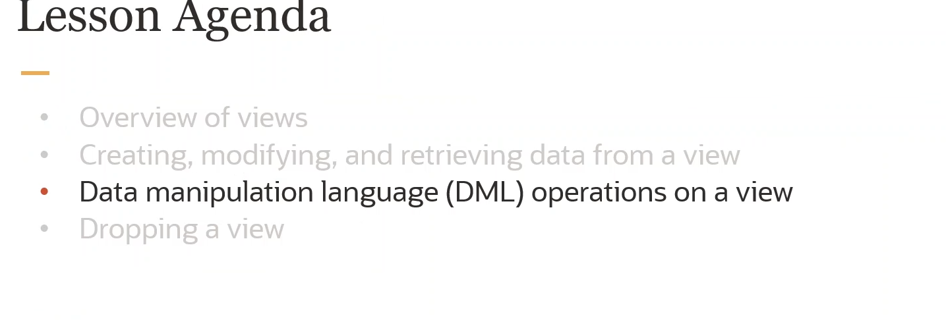

Slide 21
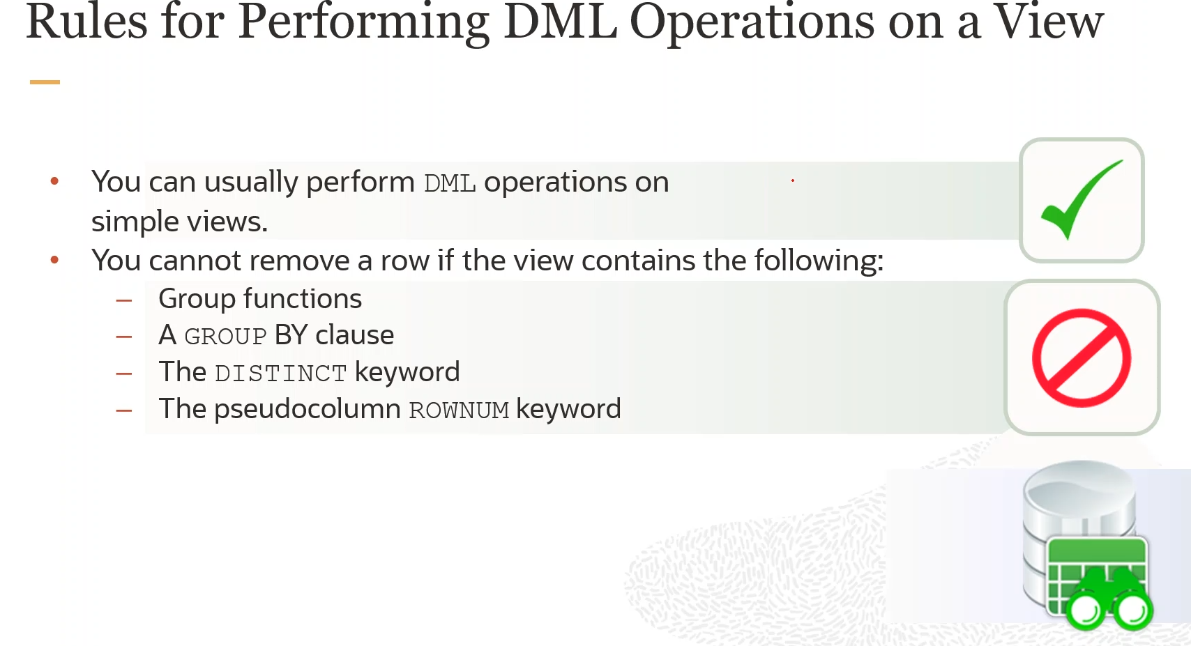

Slide 22
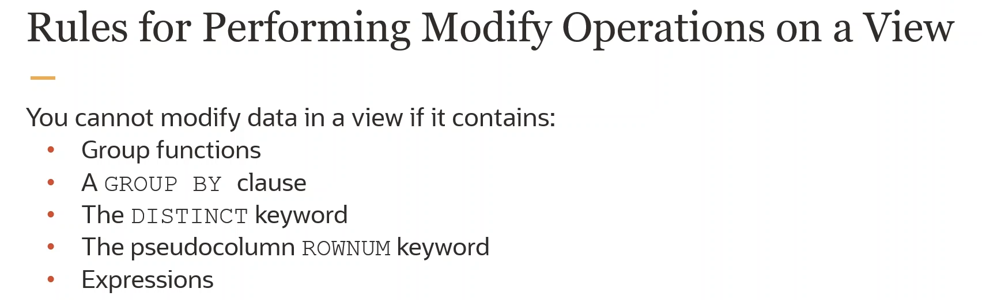

Slide 23
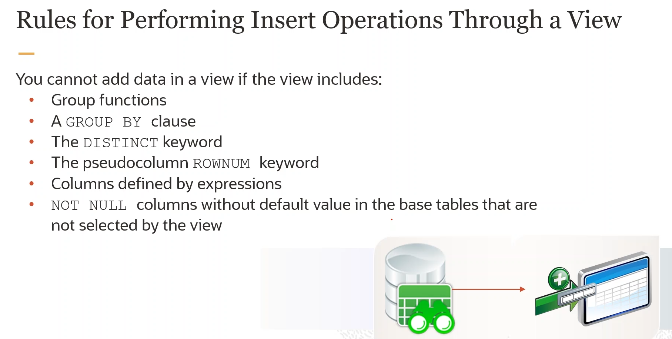

Slide 24
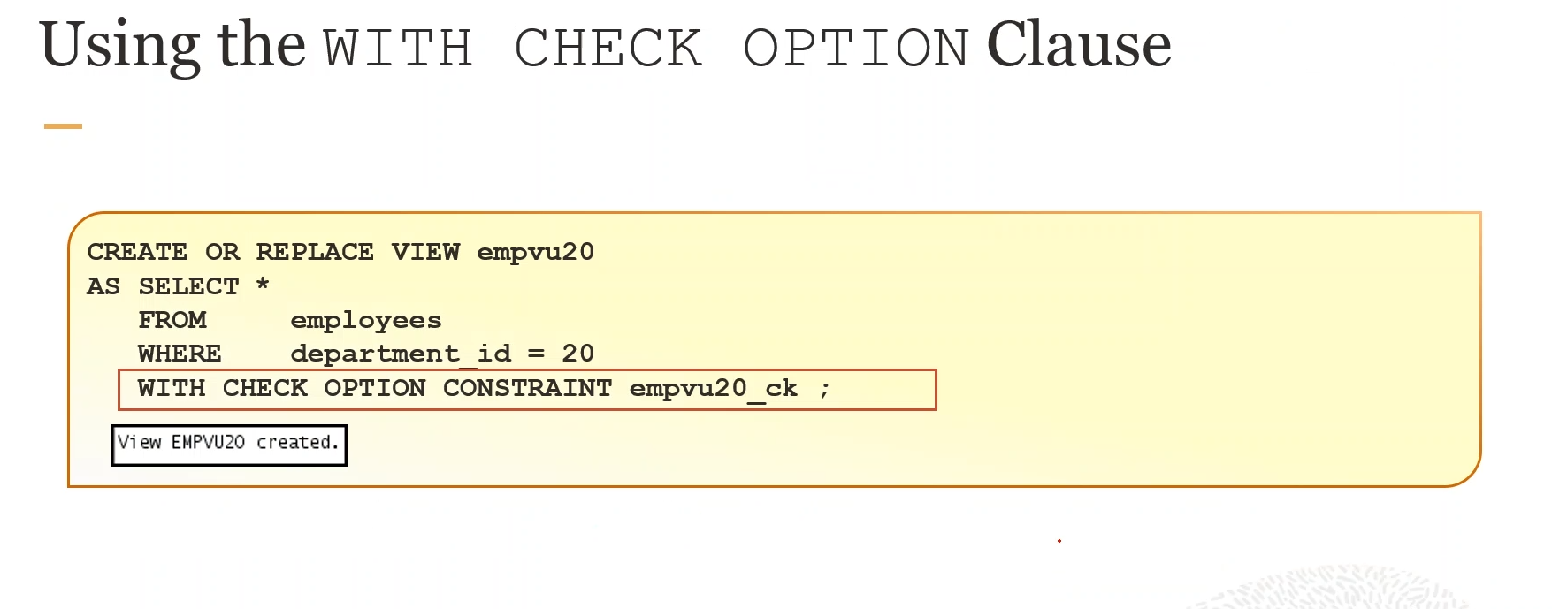

Slide 25
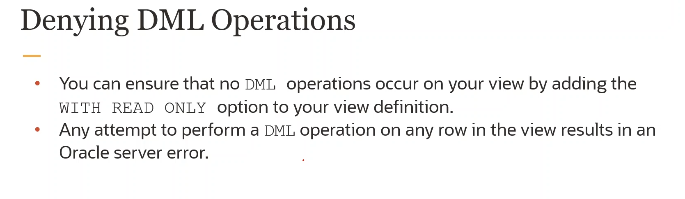

Slide 26
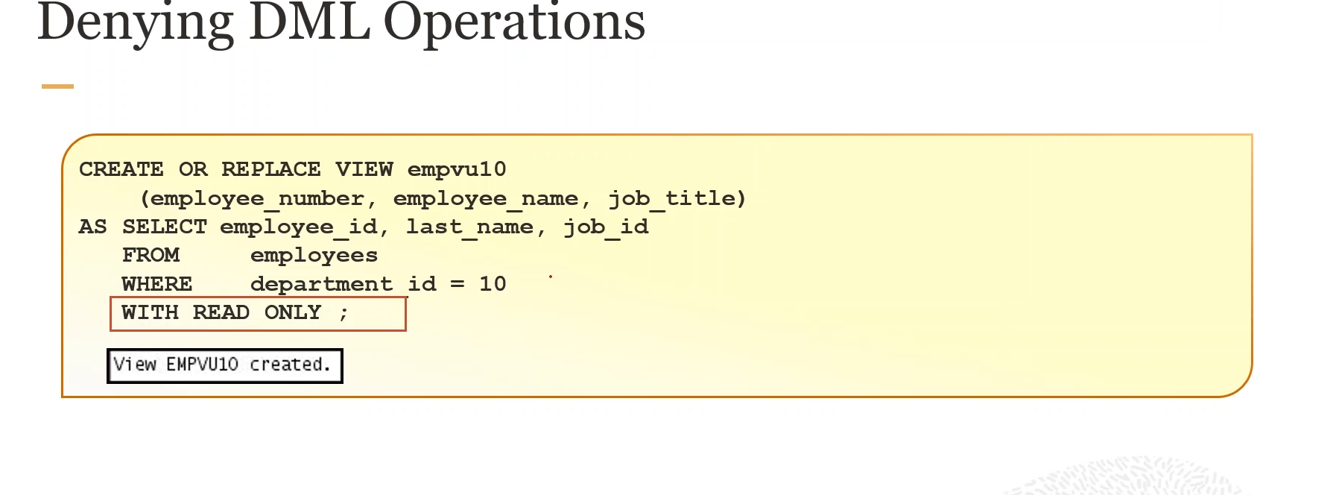

Slide 27
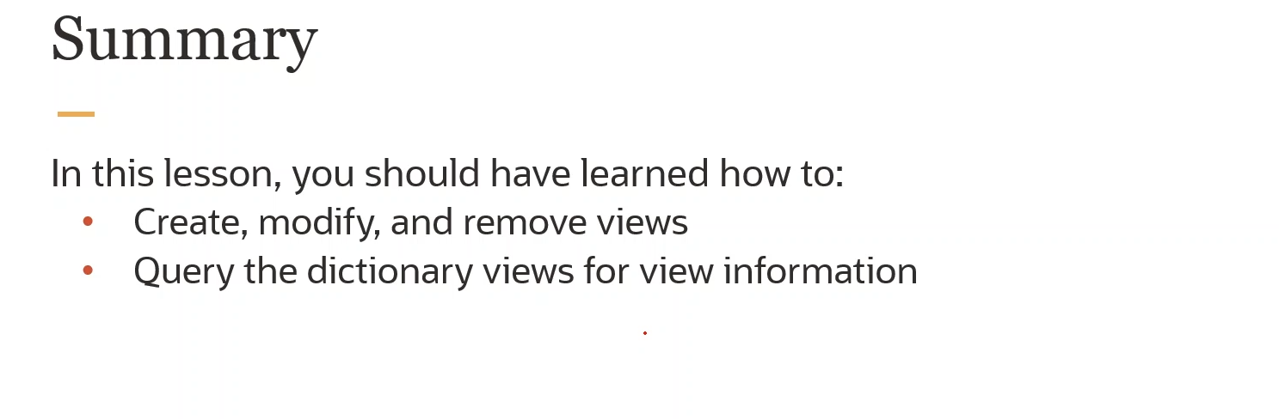

Slide 28
